Slide 1

Telecom Customer Churn Analysis
By
Eslam Mohamed Adly Hegazy,
Samah Soliman Mahmoud Mohamed,
Abdulrahman Mohamed Reda Amin,
Ibrahim Reda Ibrahim Eldesoky,
Ahmed Samir Mohamed Elrefae
Supervisor
Dr. Amal Mahmoud

Slide 2

Agenda
Introduction.
Project Objectives.
Methodology & Dataset Overview.
Tools for Analysis.
Key Findings: Churn Drivers.
Recommendations for Retention.
Conclusion.

Slide 3

Abstract: Uncovering Churn Drivers
This project analyzes the Telecom Customer Churn dataset to identify key factors causing customers to leave. Through data cleaning, exploration, and visualization using Excel, MySQL, Power BI, and Tableau, we uncover relationships between churn and factors like contract type, payment method, tenure, and service usage.

Slide 4

Introduction: The Churn Challenge
Customer churn is a critical challenge in the telecom industry. With intense competition, retaining customers is paramount. High churn rates significantly impact profitability and market share, making it essential to understand why customers leave.

Slide 5



Project Objectives
Identify Key Factors
Generate Insights
Pinpoint factors influencing churn, such as pricing, service quality, and subscription duration.
Create data-driven insights and churn indicators to identify high-risk customer segments.
Improve Retention
Support data-driven strategies for personalized deals and reduced churn rates.

Slide 6

Methodology & Dataset Overview
Analytical Workflow
Dataset Description
Our process includes data understanding, cleaning, preprocessing, exploratory data analysis (EDA), and insight extraction.
The dataset contains information on 7043 telecom customers in California, with 24 columns covering demographics, service usage, billing, and churn status.
01
CustomerID: Unique identifier
Data Understanding
Gender, Age: Demographic details
02
Tenure: Months subscribed
Cleaning & Preprocessing
Contract Type: Monthly, One year, Two years
03
MonthlyCharges, TotalCharges: Billing info
Exploratory Data Analysis
InternetService: DSL, Fiber optic, None
04
PaymentMethod: Credit card, Bank transfer, Check
Insights & Interpretation
Churn: Target variable (Yes/No)

Slide 7





Tools for Analysis
Excel
Initial data cleaning, formatting, handling missing values, and basic statistical summaries.
MySQL
Storing data, efficient querying, aggregations, and calculations using SQL commands.
Power BI
Building interactive dashboards and KPIs for dynamic filtering and churn distribution analysis.
Tableau
Advanced visual storytelling, deep visual exploration, and uncovering hidden patterns.

Slide 8





Key Findings: Churn Drivers
Contract Type
Tenure
Monthly Charges
Month-to-month contracts have the highest churn rate (42.71%).
Shorter tenure (0-1 year) customers are high risk (47.68% churn).
Higher monthly charges correlate with increased churn (35.38% for >$70).
Internet Service
Payment Method
Fiber optic users show a higher churn rate.
Electronic check users have the highest churn rate.

Slide 9
Microsoft execl
Understanding Data: The 5-Stage Analysis Process
Define Objectives: What Are We Trying to Solve?
Key Questions for Defining Objectives (Churn Analysis)
These questions help define the scope, expected outcomes, and necessary data for the entire project.
I. Quantifying the Problem (The "What")
What is the current overall Churn Rate for the observed period? (As seen: 26.58%)
What is the total financial loss associated with churned customers? (As seen: Total Loss 3M, Monthly Loss 139K)
What is the baseline Retention Rate we are working with? (As seen: 73.42%)
II. Identifying Churn Drivers (The "Why")
Which customer segments have the highest churn rates? (e.g., Which contract types, which tenure groups, which internet service types?)
How does customer behavior (e.g., Monthly Charges, Total Charges) differ between customers who churn and those who do not?
Are demographic factors (e.g., Gender, Senior Citizen status) significant predictors of churn?
What is the sentiment distribution of customers who churned versus those who stayed?
III. Setting Actionable Goals (The "How")
What is the target reduction percentage for the Churn Rate over the next quarter/year? (e.g., Reduce the churn rate by 5%)
Which specific customer group (e.g., Month-to-month contract holders in their first year) should be prioritized for retention efforts?
Can we develop a predictive model to identify high-risk customers before they churn, allowing for proactive intervention?

Slide 10
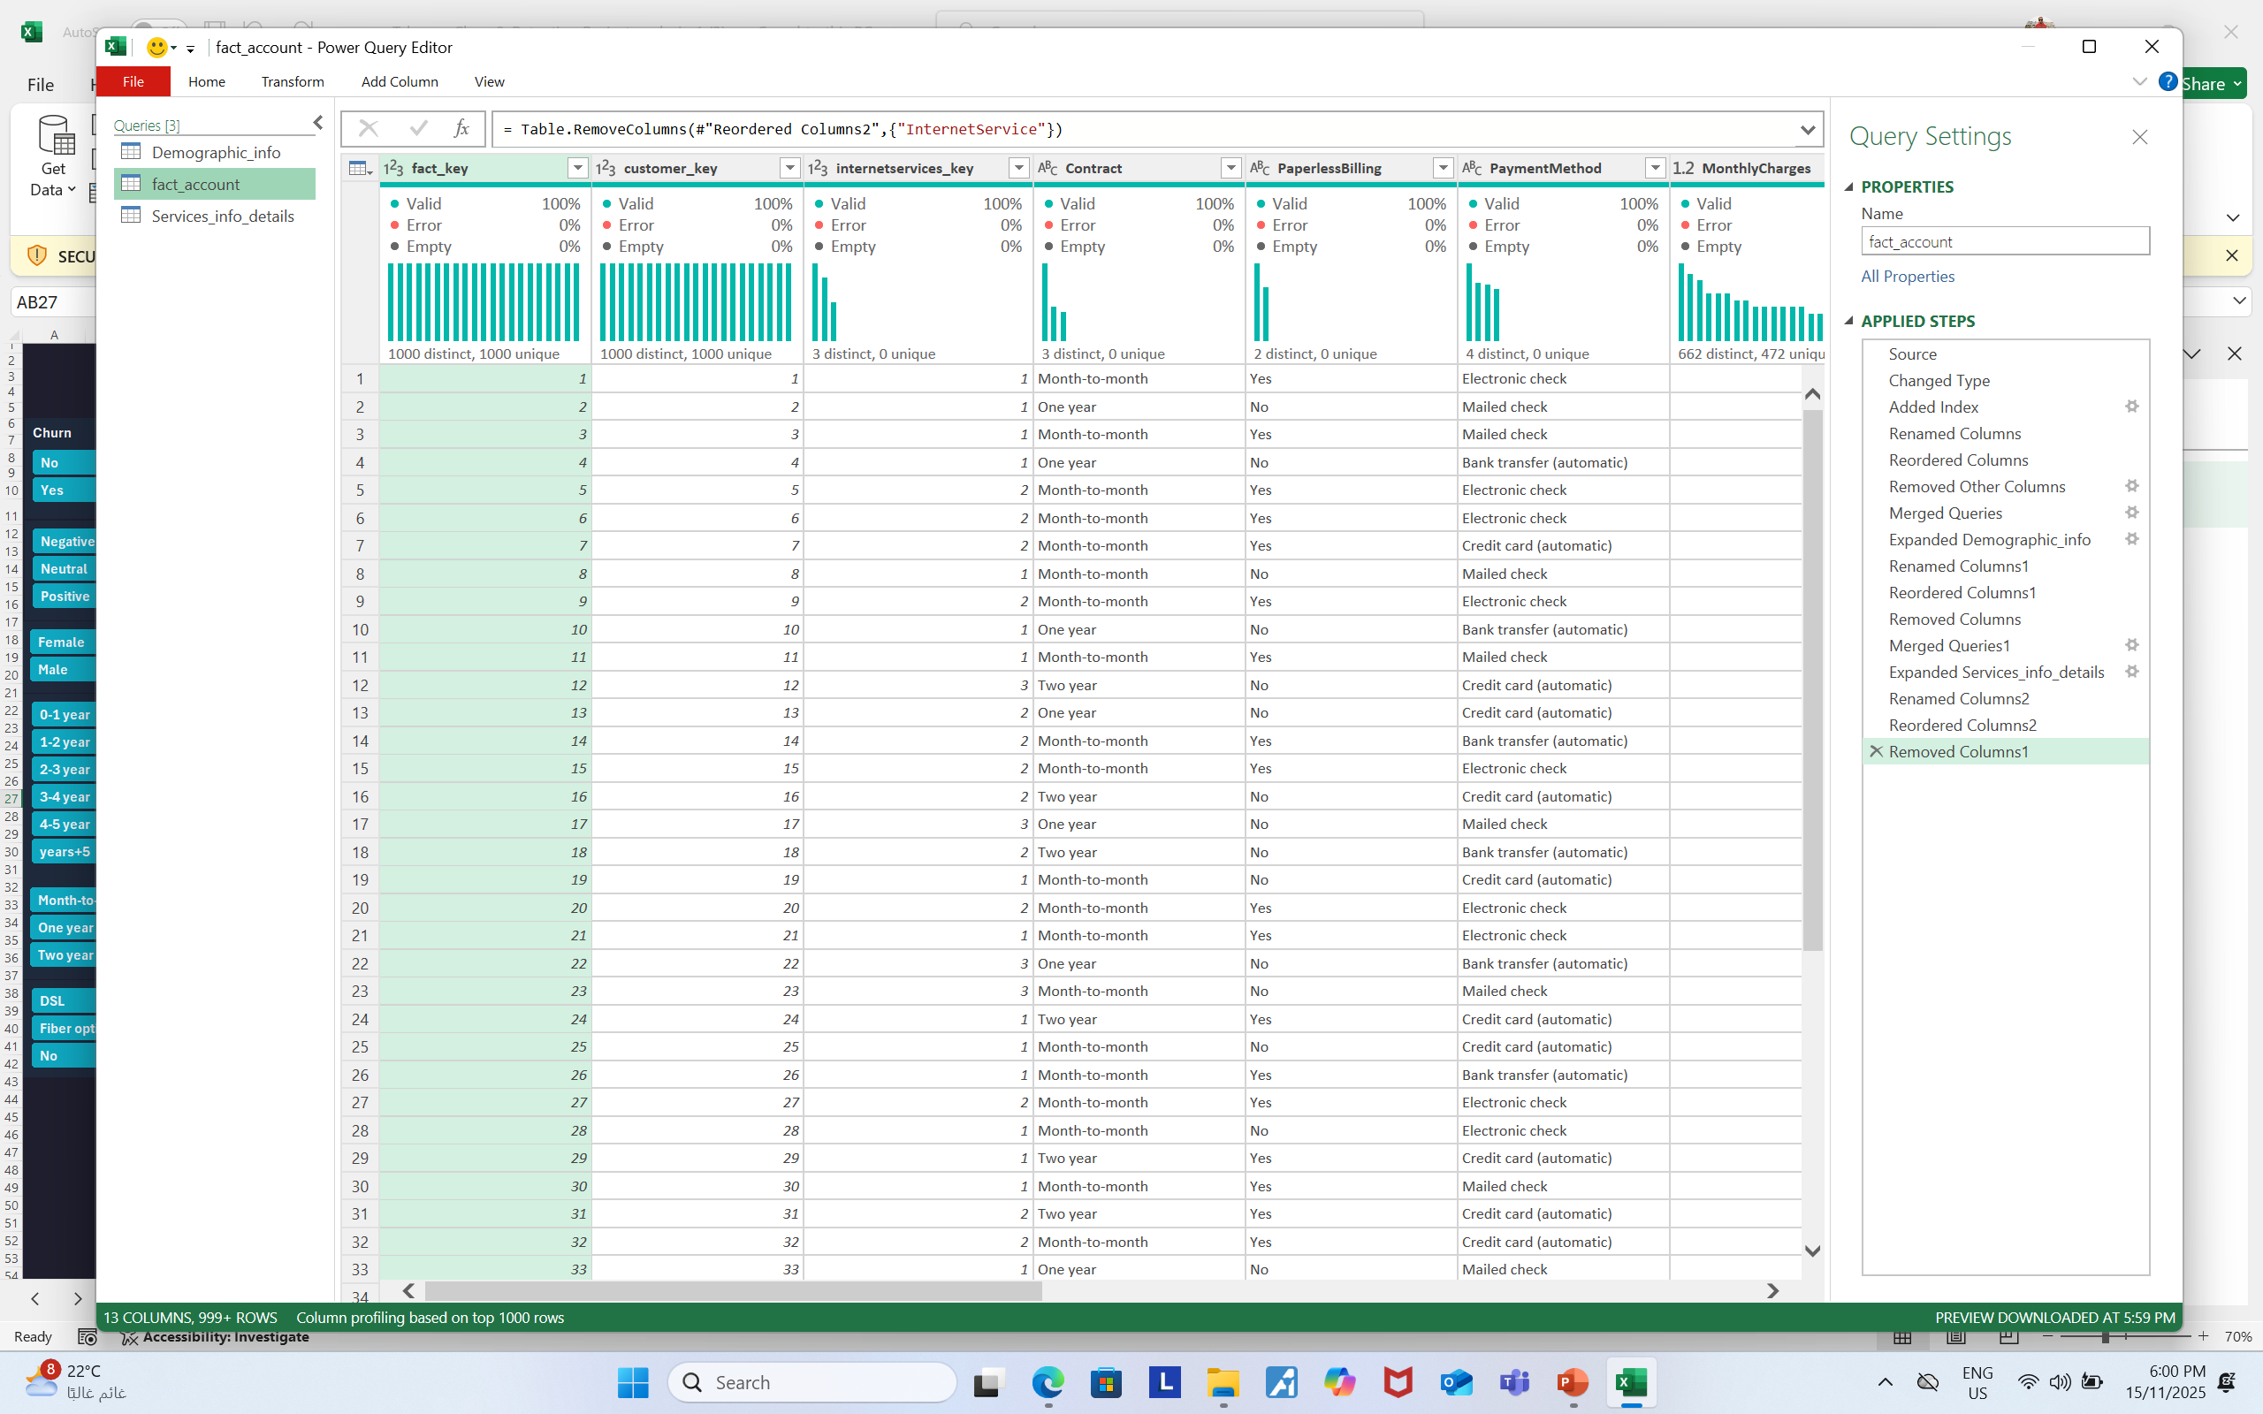
2. Data Collection: This data was taken from the Kaggle website as ready-to-use data .
3.Data Cleaning & Processing:
Identify and handle missing values (ISBLANK()).
Transform data (e.g., categorizing tenure with IF statements).
Remove duplicates.

Slide 11
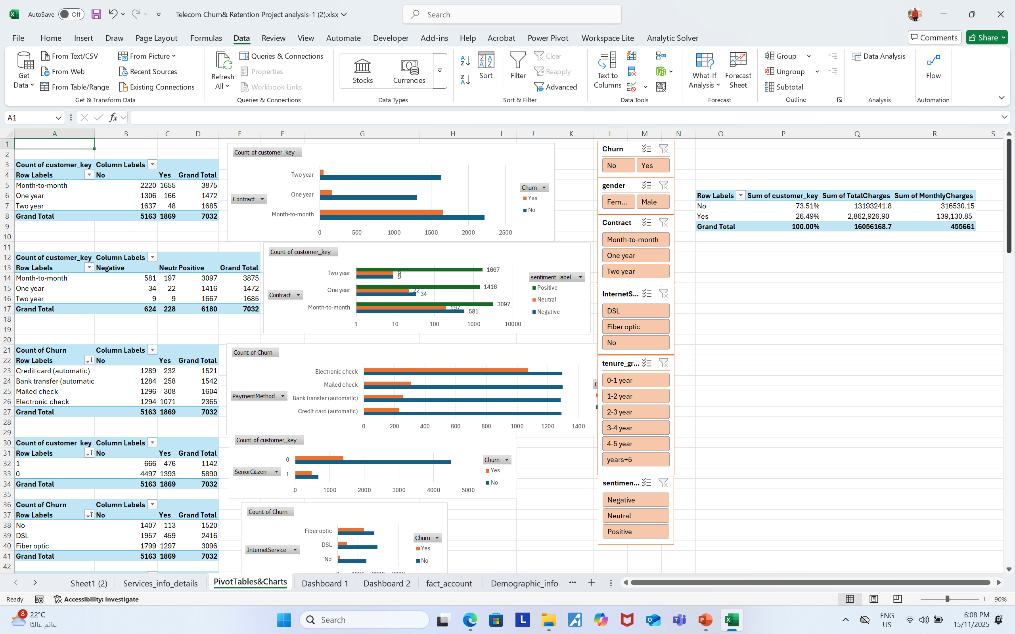
4. Data Analysis: Uncovering Patterns & Trends
Calculate descriptive statistics (AVERAGE, COUNT).
Perform cross-tabulation and aggregation using Pivot Tables.
Create calculated fields for key metrics (e.g., Churn Rate).

Slide 12
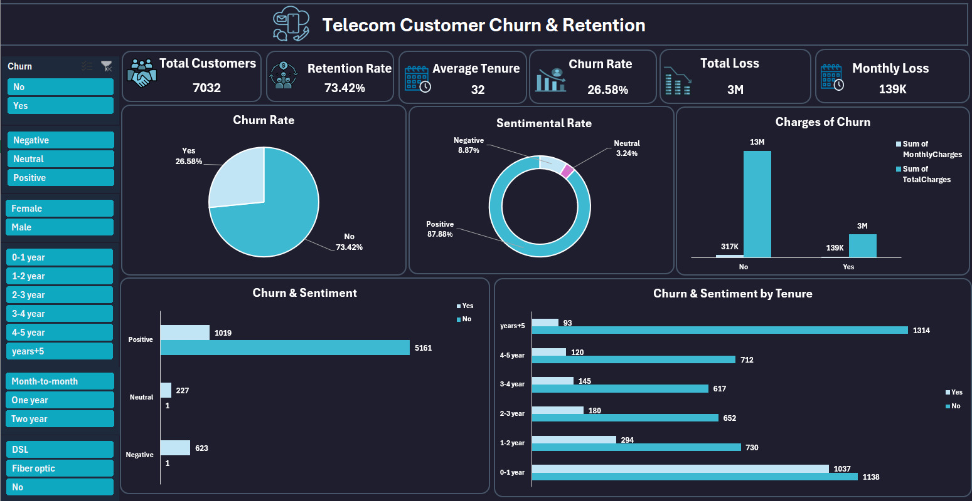
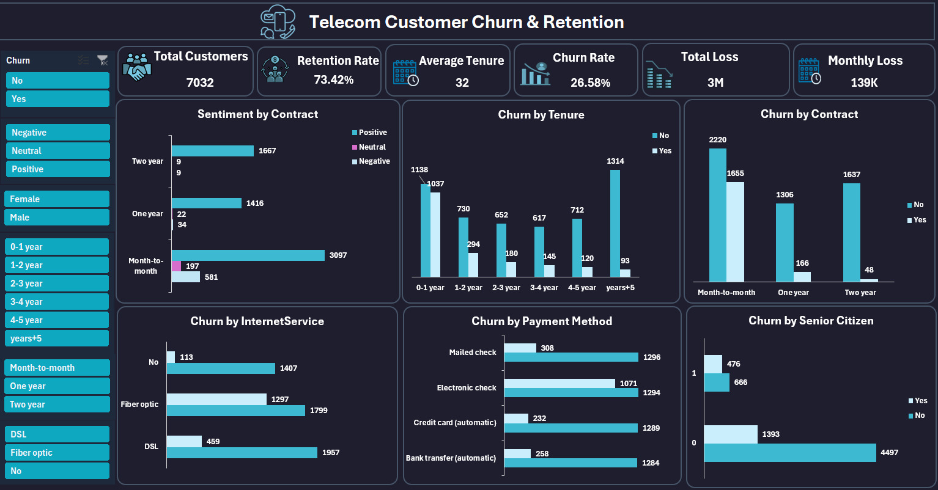
5. dashboard:
Generate various charts and graphs (bar, pie, line) for visualization.
Summarize key findings and insights in a clear narrative.
Support business recommendations with data.

Slide 13
For sql
Understanding Data: The 5-Stage Analysis Process
1.Define Objectives: What Are We Trying to Solve?
2. Data Collection: This data was taken from the Kaggle website as ready-to-use data .
.Data Cleaning & Processing:
4. Data Analysis (query): Uncovering Patterns & Trends
The present for my sql

Slide 14
For power bi

Slide 15
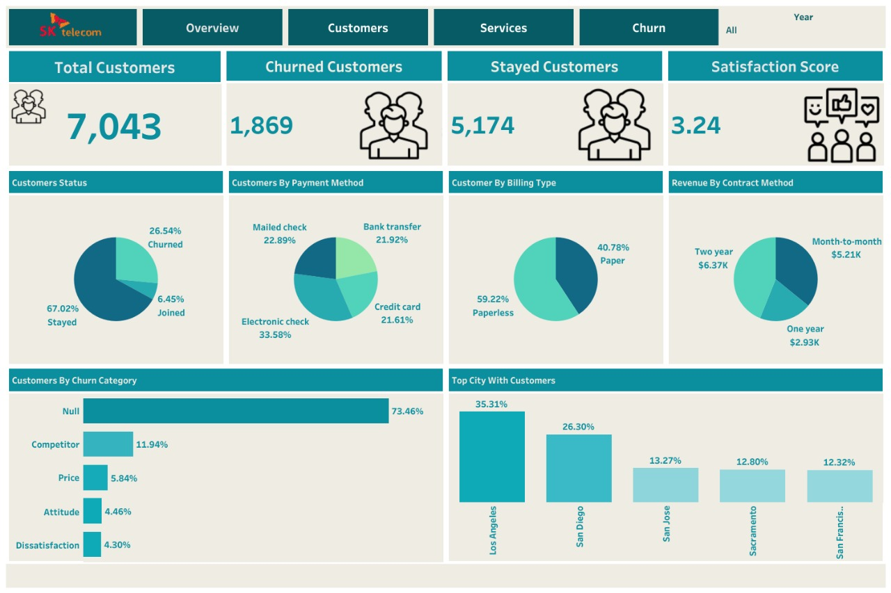
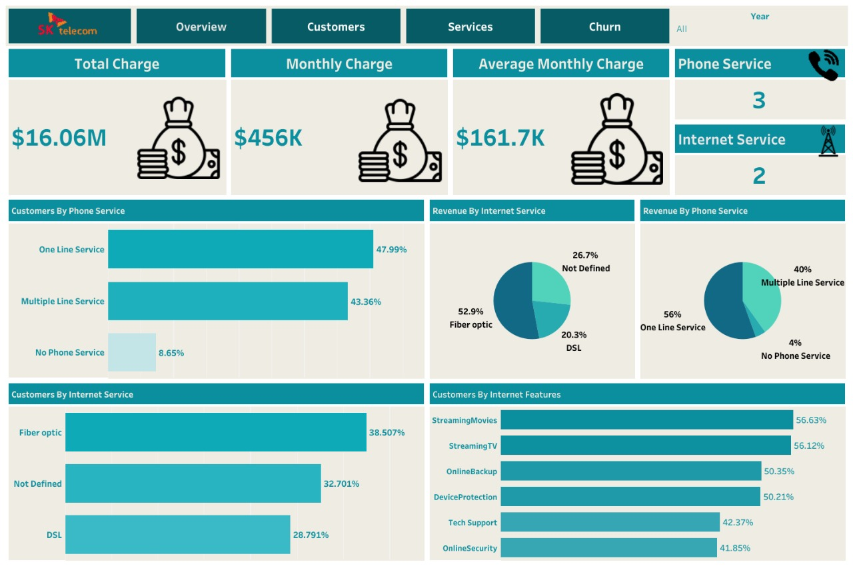
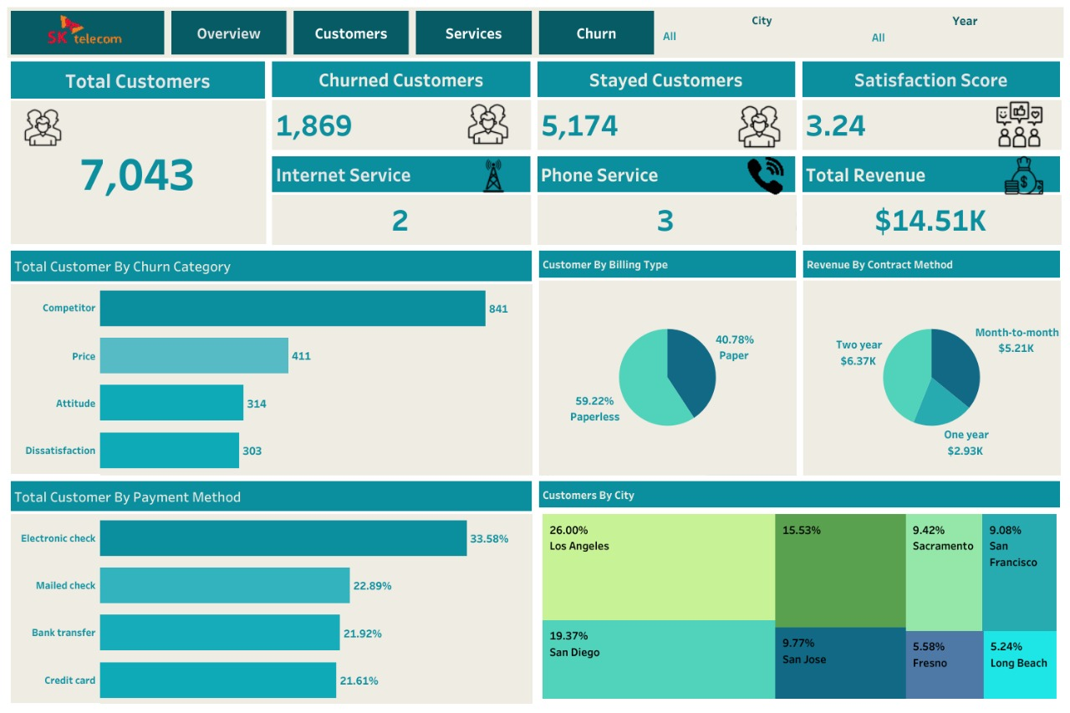
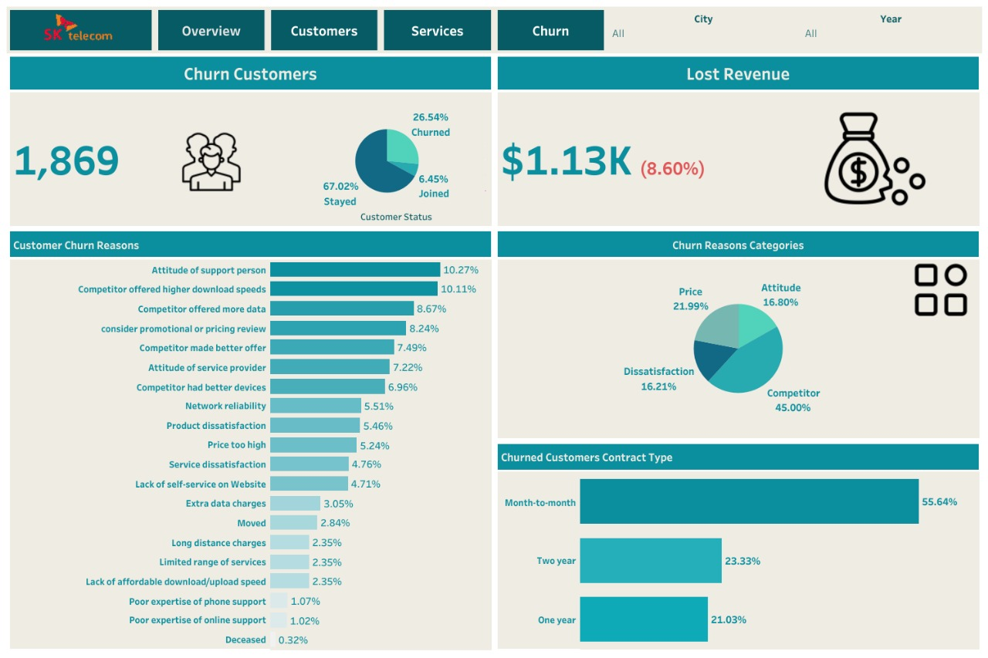
For tableau dashboard

Slide 16





Recommendations for Retention
Promote Long-Term Contracts
Offer incentives for switching from month-to-month to annual contracts.
Improve Fiber User Experience
Address service quality issues for fiber optic customers promptly.
Review Pricing Strategy
Introduce tiered pricing or loyalty discounts for high-charge customers.
Enhance Payment Options
Incentivize switching from electronic checks to more reliable methods.
Target At-Risk Customers
Proactively engage high-risk customers with personalized offers.

Slide 17

Conclusion: Driving Business Performance
Understanding and addressing customer churn is vital for telecom providers. By leveraging data-driven insights, companies can enhance customer satisfaction, reduce churn rates, and significantly improve long-term business performance.
"The ultimate goal is to support data-driven decision-making that enables telecom providers to enhance customer satisfaction, reduce churn rates, and improve long-term business performance."

